Slide 1
Bike Sharing Analysis at the city Porto, Portugal on 2011
Nan Yang – Student No.: s4481437
This presentation provides a drill-down view of the city Porto for bike sharing condition on 2011.

Slide 2
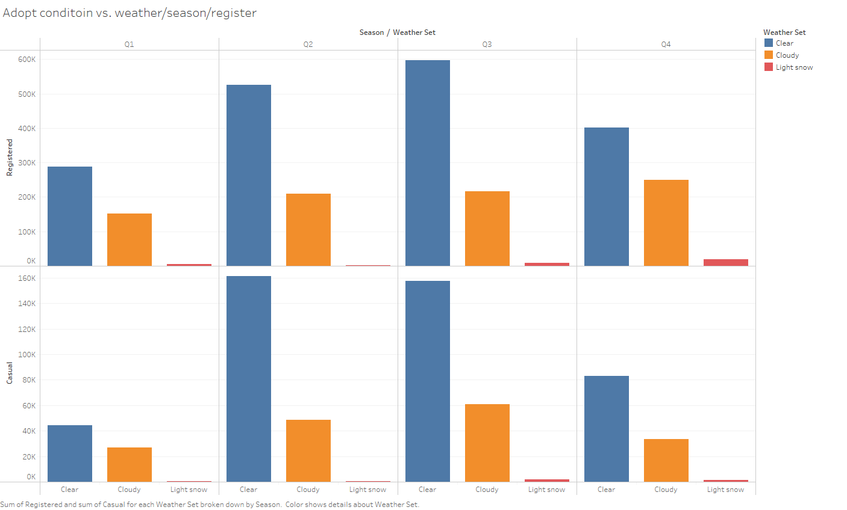
This graph shows sum of Registered and sum of Casual for each Weather Set broken down by Season.
Color shows details about Weather Set.

Slide 3
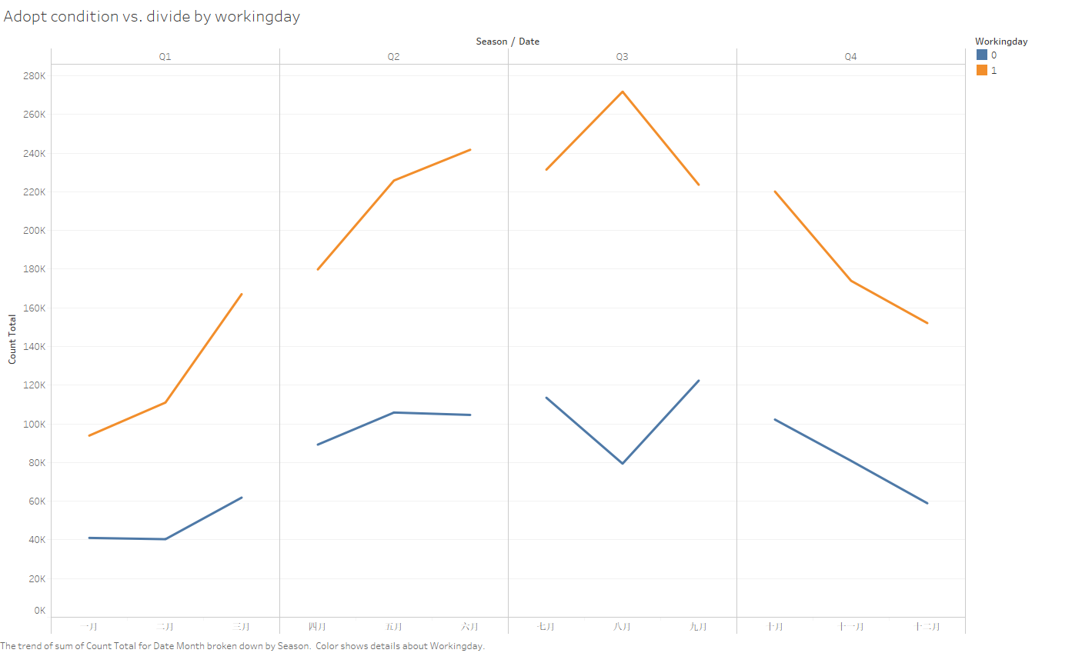
The trend of sum of Count Total for Date Month broken down by Season.
Color shows details about Working day.

Slide 4
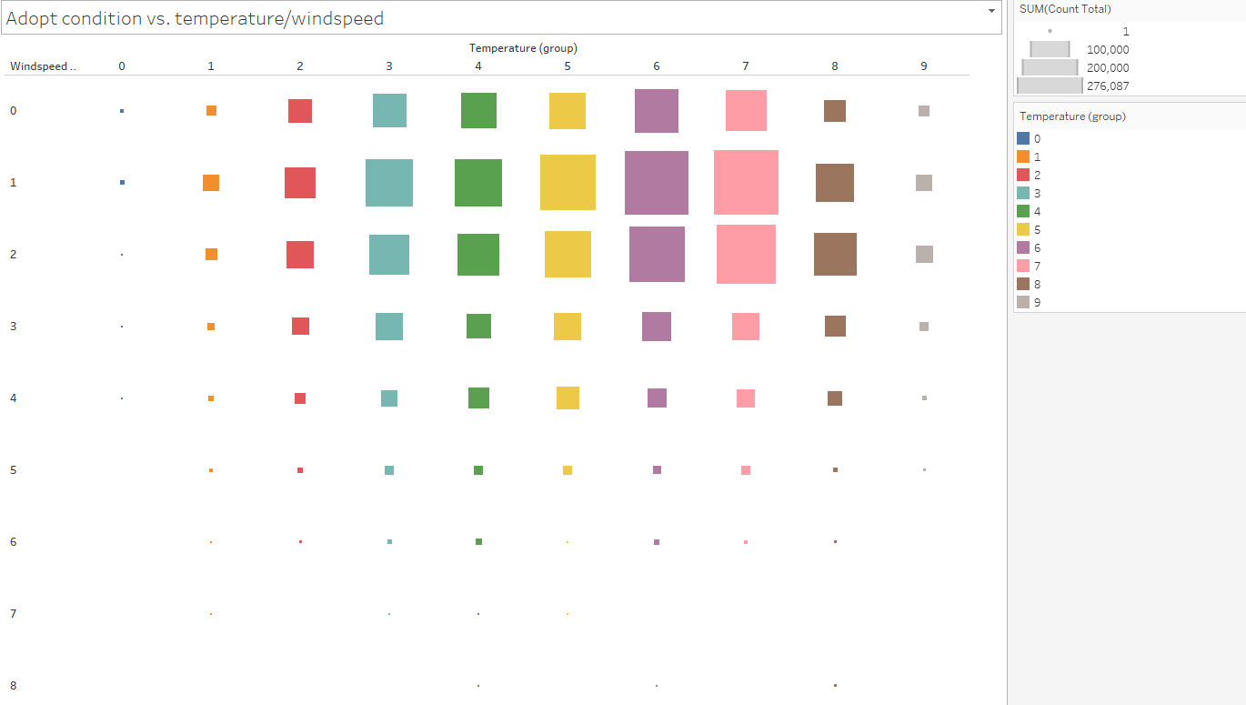
The graph shows that the volume of people including both Registered and Casual numbers adopts sharing bicycle based on various temperature and wind-
speed.
The larger the number, the higher the degree of temperature/windspeed.

